Slide 1
Kernel Perceptron Algorithm
Intuitive Explanation

Slide 2
Agenda
Data View
Algorithm iterations
Final Formulation

Slide 3
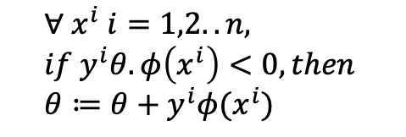
Data View
$$∀ x^{i} i=1,2..n, \\ if y^{i}θ.φ\left(x^{i}\right)<0, then \\ θ≔θ+y^{i}φ(x^{i})$$
Y | pred_1 | pred_2 | Name
1 | 3 | 2 | A
-1 | 6 | 7 | B
1 | 9 | 11 | C
B
A
C

Slide 4
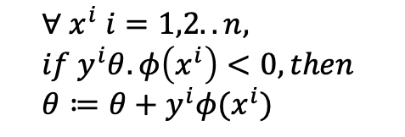
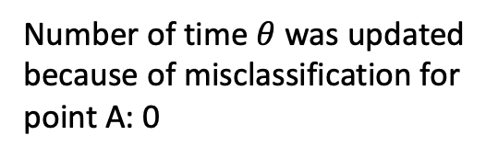
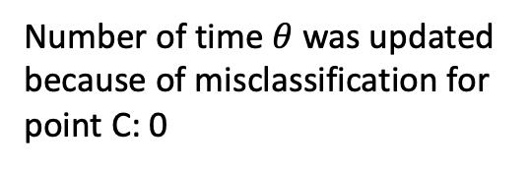
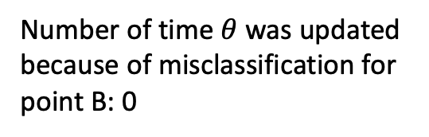
Algorithm Iterations: Iter1
$$∀ x^{i} i=1,2..n, \\ if y^{i}θ.φ\left(x^{i}\right)<0, then \\ θ≔θ+y^{i}φ(x^{i})$$
Y | pred_1 | pred_2 | Name
1 | 3 | 2 | A
-1 | 6 | 7 | B
1 | 9 | 11 | C
B
A
C
Number of time $θ$ was updated because of misclassification for point A: 0
Number of time $θ$ was updated because of misclassification for point B: 0
Number of time $θ$ was updated because of misclassification for point C: 0

Slide 5
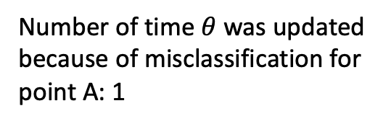
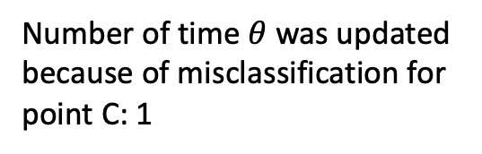
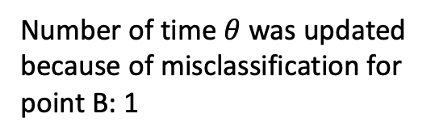
Algorithm Iterations: Iter2
$$∀ x^{i} i=1,2..n, \\ if y^{i}θ.φ\left(x^{i}\right)<0, then \\ θ≔θ+y^{i}φ(x^{i})$$
Y | pred_1 | pred_2 | Name
1 | 3 | 2 | A
-1 | 6 | 7 | B
1 | 9 | 11 | C
B
A
C
Number of time $θ$ was updated because of misclassification for point A: 1
Number of time $θ$ was updated because of misclassification for point B: 1
Number of time $θ$ was updated because of misclassification for point C: 1

Slide 6
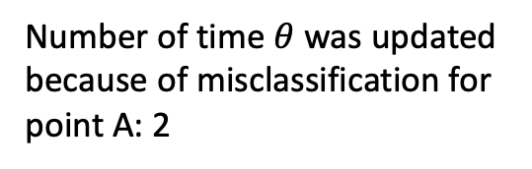
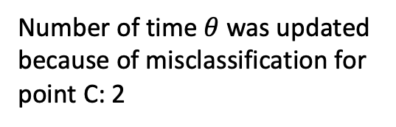
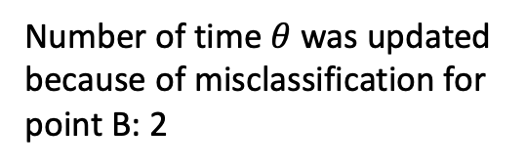
Algorithm Iterations: Iter3
$$∀ x^{i} i=1,2..n, \\ if y^{i}θ.φ\left(x^{i}\right)<0, then \\ θ≔θ+y^{i}φ(x^{i})$$
Y | pred_1 | pred_2 | Name
1 | 3 | 2 | A
-1 | 6 | 7 | B
1 | 9 | 11 | C
B
A
C
Number of time $θ$ was updated because of misclassification for point A: 2
Number of time $θ$ was updated because of misclassification for point B: 2
Number of time $θ$ was updated because of misclassification for point C: 2

Slide 7
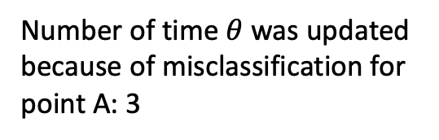
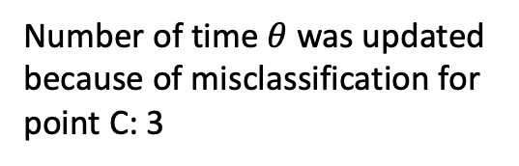
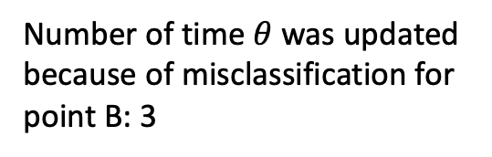
Algorithm Iterations: Iter4
$$∀ x^{i} i=1,2..n, \\ if y^{i}θ.φ\left(x^{i}\right)<0, then \\ θ≔θ+y^{i}φ(x^{i})$$
Y | pred_1 | pred_2 | Name
1 | 3 | 2 | A
-1 | 6 | 7 | B
1 | 9 | 11 | C
B
A
C
Number of time $θ$ was updated because of misclassification for point A: 3
Number of time $θ$ was updated because of misclassification for point B: 3
Number of time $θ$ was updated because of misclassification for point C: 3

Slide 8
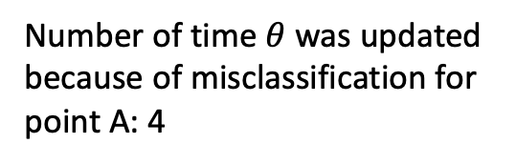
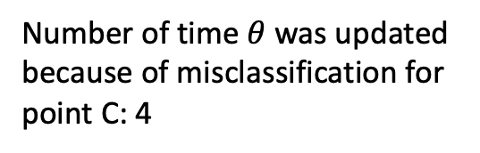
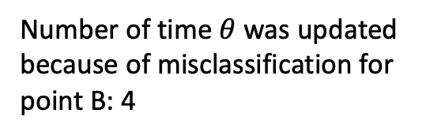
Algorithm Iterations: Iter5
$$∀ x^{i} i=1,2..n, \\ if y^{i}θ.φ\left(x^{i}\right)<0, then \\ θ≔θ+y^{i}φ(x^{i})$$
Y | pred_1 | pred_2 | Name
1 | 3 | 2 | A
-1 | 6 | 7 | B
1 | 9 | 11 | C
B
A
C
Number of time $θ$ was updated because of misclassification for point A: 4
Number of time $θ$ was updated because of misclassification for point B: 4
Number of time $θ$ was updated because of misclassification for point C: 4

Slide 9

Algorithm Iterations: Iter5
$$∀ x^{i} i=1,2..n, \\ if y^{i}θ.φ\left(x^{i}\right)<0, then \\ θ≔θ+y^{i}φ(x^{i})$$
Y | pred_1 | pred_2 | Name
1 | 3 | 2 | A
-1 | 6 | 7 | B
1 | 9 | 11 | C
B
A
C
Number of time $θ$ was updated because of misclassification for point A: 4
Number of time $θ$ was updated because of misclassification for point B: 4
Number of time $θ$ was updated because of misclassification for point C: 4
$$θ_{final}=∑α_{i}y_{i}φ(x_{i})$$

Slide 10
Algorithm Iterations: Final Formulation
$$∀ x^{i} i=1,2..n, \\ if y^{i}θ.φ\left(x^{i}\right)<0, then \\ θ≔θ+y^{i}φ(x^{i})$$
Y | pred_1 | pred_2 | Name
1 | 3 | 2 | A
-1 | 6 | 7 | B
1 | 9 | 11 | C
? | 5.5 | 6.5 | D
B
A
C
$$θ_{final}=∑α_{i}y_{i}φ(x_{i})$$

Slide 11

Algorithm Iterations: Final Formulation
$$∀ x^{i} i=1,2..n, \\ if y^{i}θ.φ\left(x^{i}\right)<0, then \\ θ≔θ+y^{i}φ(x^{i})$$
Y | pred_1 | pred_2 | Name
1 | 3 | 2 | A
-1 | 6 | 7 | B
1 | 9 | 11 | C
? | 5.5 | 6.5 | D
B
A
C
$$θ_{final}=∑α_{i}y_{i}φ(x_{i})$$
$$θ_{final}.{φ(x}_{d})$$

Slide 12

Algorithm Iterations: Final Formulation
$$∀ x^{i} i=1,2..n, \\ if y^{i}θ.φ\left(x^{i}\right)<0, then \\ θ≔θ+y^{i}φ(x^{i})$$
Y | pred_1 | pred_2 | Name
1 | 3 | 2 | A
-1 | 6 | 7 | B
1 | 9 | 11 | C
? | 5.5 | 6.5 | D
B
A
C
$$θ_{final}=∑α_{i}y_{i}φ(x_{i})$$
$${sign(θ}_{final}.{φ(x}_{d}))$$

Slide 13

Algorithm Iterations: Final Formulation
$$∀ x^{i} i=1,2..n, \\ if y^{i}θ.φ\left(x^{i}\right)<0, then \\ θ≔θ+y^{i}φ(x^{i})$$
Y | pred_1 | pred_2 | Name
1 | 3 | 2 | A
-1 | 6 | 7 | B
1 | 9 | 11 | C
? | 5.5 | 6.5 | D
B
A
C
$$θ_{final}=∑α_{i}y_{i}φ(x_{i})$$
$$sign(θ_{final}.{φ(x}_{d}))$$

Slide 14
Algorithm Iterations: Final Formulation
$$∀ x^{i} i=1,2..n, \\ if y^{i}θ.φ\left(x^{i}\right)<0, then \\ θ≔θ+y^{i}φ(x^{i})$$
Y | pred_1 | pred_2 | Name
1 | 3 | 2 | A
-1 | 6 | 7 | B
1 | 9 | 11 | C
? | 5.5 | 6.5 | D
B
A
C
$$θ_{final}=∑α_{i}y_{i}φ(x_{i})$$
$$sign\left(θ_{final}.{φ(x}_{d})\right)=sign(∑α_{i}y_{i}φ\left(x_{i}\right).φ\left(x_{d}\right))$$

Slide 15
Algorithm Iterations: Final Formulation
$$∀ x^{i} i=1,2..n, \\ if y^{i}θ.φ\left(x^{i}\right)<0, then \\ θ≔θ+y^{i}φ(x^{i})$$
Y | pred_1 | pred_2 | Name
1 | 3 | 2 | A
-1 | 6 | 7 | B
1 | 9 | 11 | C
? | 5.5 | 6.5 | D
B
A
C
$$θ_{final}=∑α_{i}y_{i}φ(x_{i})$$
$$sign\left(θ_{final}.{φ(x}_{d})\right)=sign(∑α_{i}y_{i}φ\left(x_{i}\right).φ\left(x_{d}\right))$$

Slide 16

Algorithm Iterations: Final Formulation
$$∀ x^{i} i=1,2..n, \\ if y^{i}θ.φ\left(x^{i}\right)<0, then \\ θ≔θ+y^{i}φ(x^{i})$$
Y | pred_1 | pred_2 | Name
1 | 3 | 2 | A
-1 | 6 | 7 | B
1 | 9 | 11 | C
? | 5.5 | 6.5 | D
B
A
C
$$θ_{final}=∑α_{i}y_{i}φ(x_{i})$$
$$K(x_{i},x_{d})$$
$$sign\left(θ_{final}.{φ(x}_{d})\right)=sign(∑α_{i}y_{i}φ\left(x_{i}\right).φ\left(x_{d}\right))$$

